Slide 1

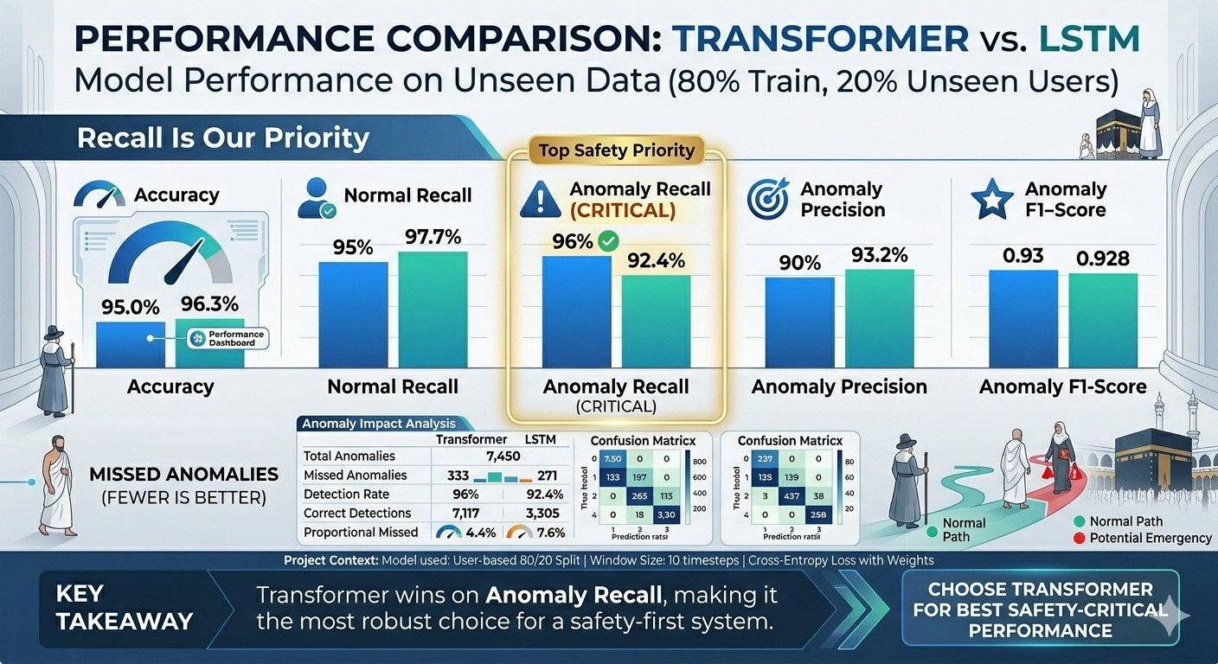
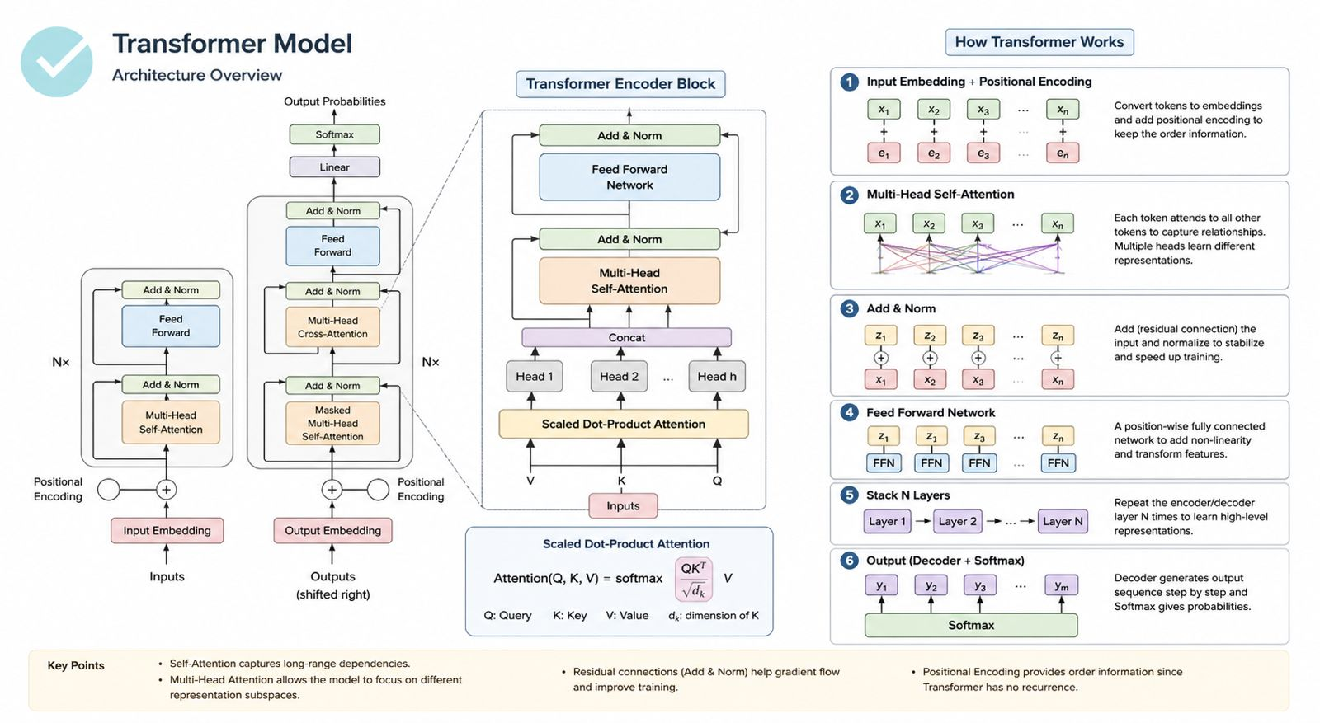
Google Maps Platform Documentation.
Firebase Documentation (Realtime Database & Cloud Functions).
TensorFlow and Keras Documentation.
Scikit-learn Documentation.
Research papers on GPS-based anomaly detection and crowd monitoring.
Masar: AI-Powered Pilgrim Tracking and Safety System (Hajj track)
Abdulaziz Fahad Etaiwi, Faisal Abdulkarim Almars, Omar Safwat Alshargawi, Safwan Mohammed Alimam, Abdulrahman Alsumairi
Dr. Anas Alkarim
College of Computer Science and Engineering, Artificial Intelligence
Introduction
Results and Discussion
Hajj is one of the largest annual gatherings in the world, where millions of pilgrims move simultaneously between key locations such as Mina, Arafat, Muzdalifah, and Makkah. Managing such massive crowds is a significant challenge for Hajj campaign supervisors, who are responsible for ensuring that all pilgrims remain safe, organized, and within their assigned groups. Traditional methods, such as manual headcounts and paper-based tracking, are often inefficient, time-consuming, and prone to human error, especially in highly crowded environments.
To address these challenges, this project proposes Masar, an AI-powered pilgrim tracking and safety system designed to assist supervisors in monitoring their groups in real time. The system leverages GPS-based location tracking, a centralized dashboard, and intelligent data analysis to provide continuous awareness of each pilgrim’s status. By defining a dynamic range around the supervisor, the system can automatically determine whether pilgrims are within the group or out of range.
In addition, Masar incorporates an AI model that analyzes movement patterns using features such as speed, direction changes, and distance variations to detect abnormal behavior. This enables early identification of potential risks and triggers immediate alerts, helping improve safety and coordination during Hajj.
The Masar system was successfully implemented as a functional prototype integrating real-time GPS tracking, a supervisor dashboard, and an AI-based anomaly detection model. The system demonstrated reliable tracking of pilgrims and was able to correctly identify out-of-range cases using the dynamic geofencing approach.
The LSTM-based model showed high overall accuracy in detecting normal versus abnormal movement patterns when tested on sequential GPS data. Using engineered features such as speed, distance change, and direction variation improved the model’s ability to capture meaningful behavioral patterns rather than relying on raw coordinates alone.
Real-time alerts were generated with low latency and displayed مباشرة on the supervisor dashboard, allowing quick response to potential issues. This confirms the system’s effectiveness in reducing delays compared to manual monitoring methods.
However, some limitations were observed. The system’s performance depends on the quality and consistency of GPS signals, which may be affected in highly crowded or dense urban areas. Additionally, the dataset used for training was relatively limited, which may affect generalization in real-world scenarios.
Overall, the results indicate that Masar is a promising solution for improving group monitoring and safety during Hajj, with strong potential for further optimization and large-scale deployment.
Objectives
Develop a real-time tracking system that continuously monitors pilgrims’ locations during Hajj using GPS-enabled devices or mobile applications.
Provide supervisors with a centralized dashboard that visualizes group members on a live map and displays their current status clearly.
Implement a dynamic geofencing approach based on the supervisor’s location to automatically identify pilgrims who move out of the group range.
Design and integrate an AI-based model to analyze movement patterns (e.g., speed, distance, and direction changes) and detect abnormal behavior.
Enable instant alert and notification mechanisms for out-of-range cases or emergency situations through an SOS feature.
Conclusion
Masar presents an effective and practical solution for improving pilgrim safety and group management during Hajj. By combining real-time GPS tracking, a dynamic geofencing approach, and AI-based behavior analysis, the system enables supervisors to monitor pilgrims more efficiently and respond quickly to potential risks.
The prototype demonstrated the ability to detect out-of-range and abnormal movement patterns with high accuracy while providing instant alerts through a centralized dashboard. This reduces reliance on manual tracking methods and enhances overall coordination in highly crowded environments.
With further development, including larger real-world datasets and system optimization, Masar has strong potential for real-world deployment and can contribute to smarter, safer crowd management solutions in large-scale events.
Methods
The Masar system was developed using an integrated architecture combining mobile applications, web technologies, and AI-based analysis. A pilgrim-side mobile application (or GPS wearable) collects real-time location data and sends it to a cloud backend using Firebase Realtime Database.
On the supervisor side, a web-based dashboard built with React.js and Google Maps API visualizes all pilgrims’ locations in real time and displays their status (in-range or out-of-range). A dynamic geofencing mechanism is applied based on the supervisor’s current location to determine group boundaries.
For intelligent analysis, a Python-based AI model (LSTM) processes engineered features derived from GPS data, such as speed, distance changes, direction variation, time gaps, and distance from the supervisor. Data is analyzed in sequential windows to detect abnormal movement patterns.
When anomalies or out-of-range cases are detected, alerts are generated and sent back to the dashboard instantly, enabling supervisors to take immediate action.
References
Google Maps Platform Documentation
Firebase Documentation (Realtime Database & Cloud Functions)
TensorFlow/Keras Documentation
Relevant research papers on GPS-based anomaly detection and crowd monitoring
Acknowledgements
We would like to thank our supervisor for their guidance and support throughout this project. We also appreciate the resources and support provided by the College of Science and Computer Engineering.

